Slide 1
Project 96 Disastrous Tweets Classification Mentor : Munmun Mam
Group – 3
Team members:
Monit kumar
aAshrit j rao
y. Manoj kumar
Lazin Mohammad abdussukkoor
Govin kshirsagar
Soumyabrata Banerjee
Mafeeda T

Slide 2
Problem Statement :
One of our clients is a disaster relief organization. So, they actually rely upon twitter as an important medium for their communication. But they often get misled with the kind of tweets whether that actually implies the disaster or not.
Target :
Build the classification model to predict from the tweet which is real disaster and which is not

Slide 3
Project Flow
Extracting tweets from twitter
Preparing Dataset
Exploratory Data Analysis
Data Pre-processing
Model Building
Model Deployment

Slide 4
Extracting tweets from twitter
Extraction of tweets based on disastrous keywords were done manually by searching the posts on twitter handle.
Used keywords like earthquake, tsunami, flood, landslide, avalanche etc…
About The Dataset
The dataset consists of 11370 data's of different disastrous and non disastrous tweets and has five columns which are id, keyword, location, text and target respectively.
id :- Represents the index number.
keyword :- Represents which disastrous word its related to.
text :- Contains all the tweets extracted based on each keyword and location.
target :- Shows weather the tweet is disastrous or not.

Slide 5
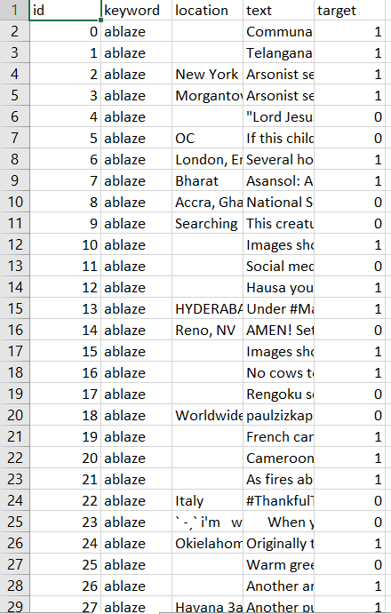
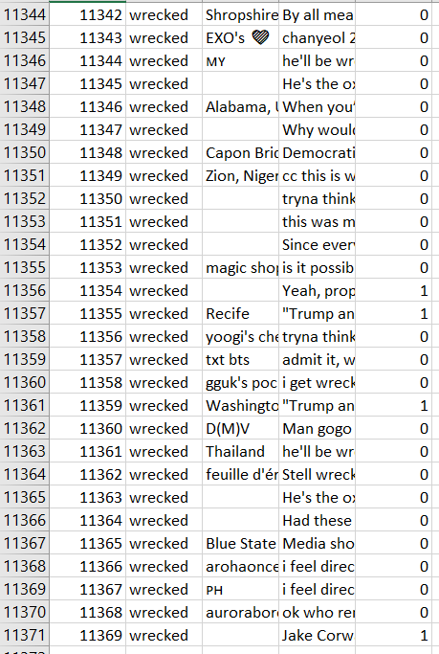

Slide 6
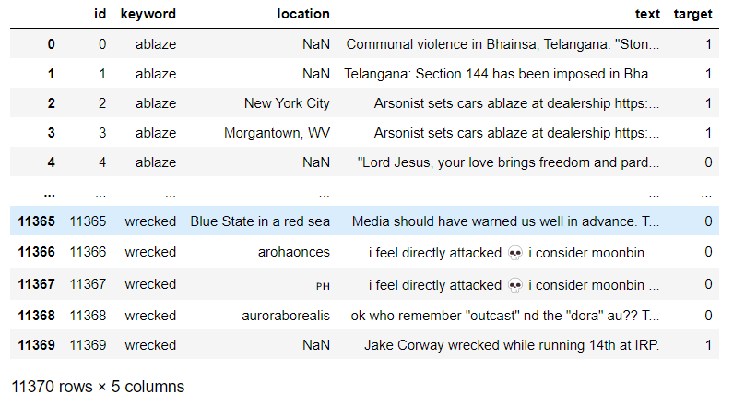
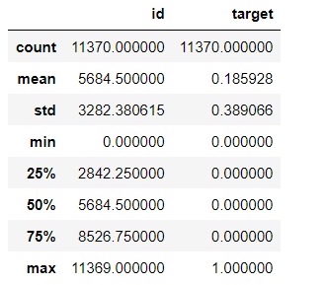
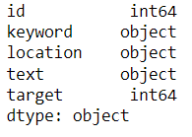
EDA AND DATA CLEANING

Slide 7
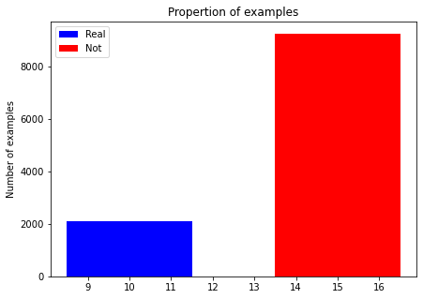
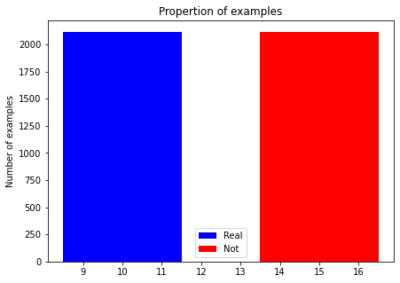
Unbalanced Dataset
Balanced Dataset

Slide 8
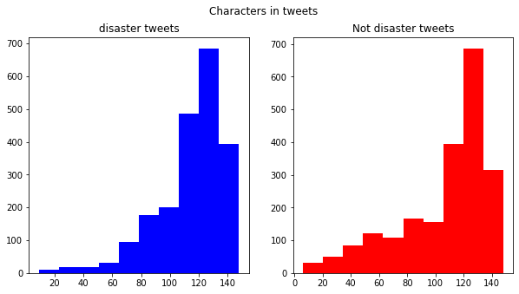
Characters in Tweets

Slide 9
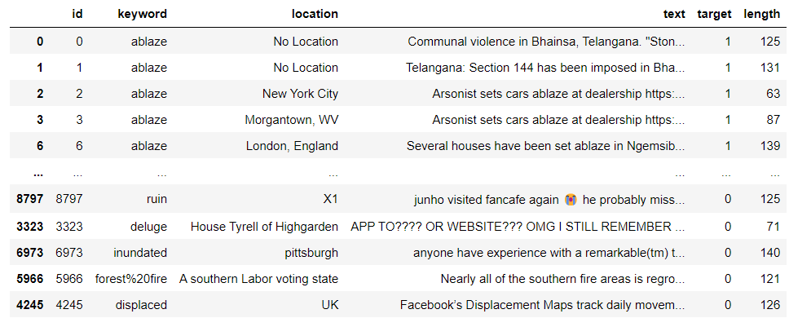
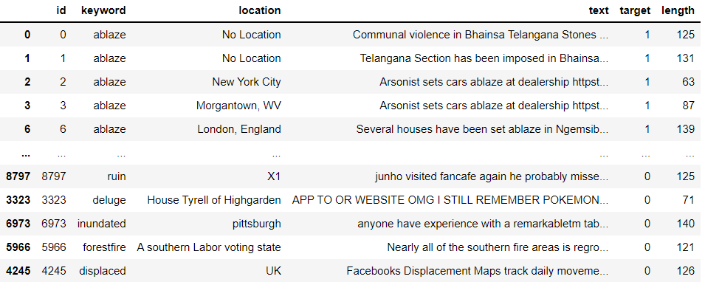
Removal of Emojis, commas etc…

Slide 10
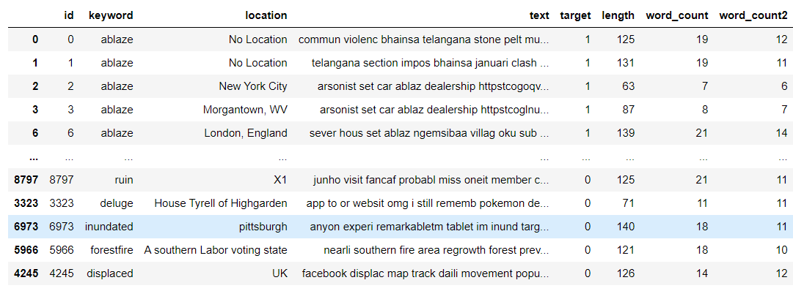
Removed all special characters and links

Slide 11
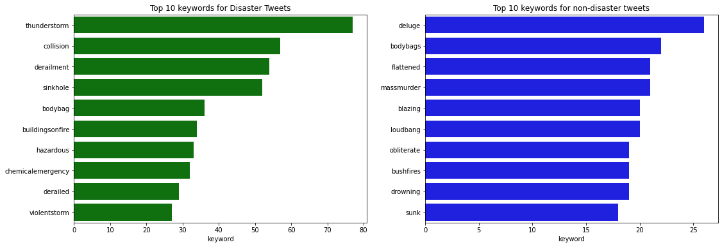
Top 10 keywords

Slide 12
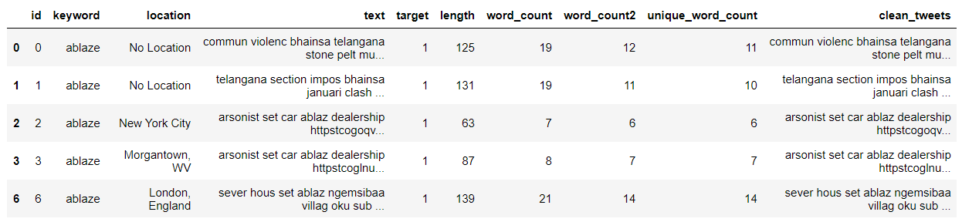
Converted uppercase to lowercase, removed punctuation and removed extra space and tabs.

Slide 13
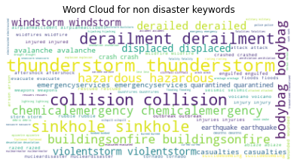
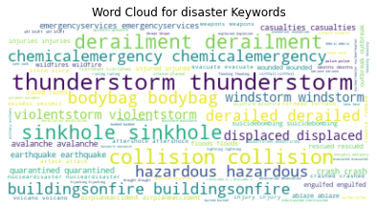
Word Cloud

Slide 14
From the word cloud we can see that the data is cleaned well and all the emojis special characters are removed from the data.
The next step is to do model building.
Before model building we have to split the data set into test and train.

Slide 15
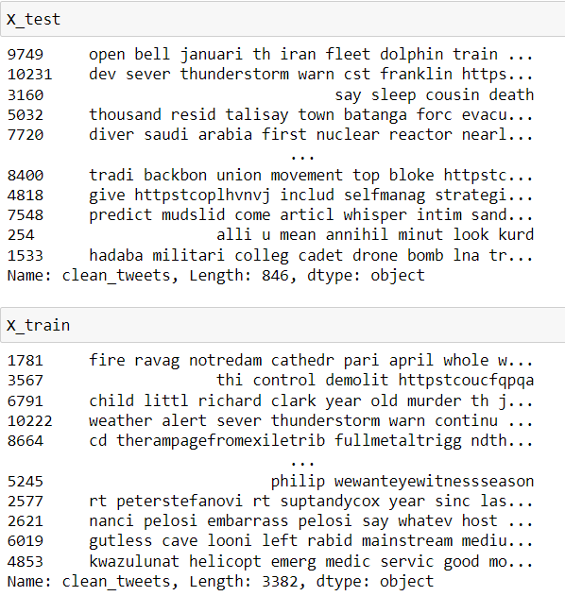
Splitting dataset to test and train

Slide 16
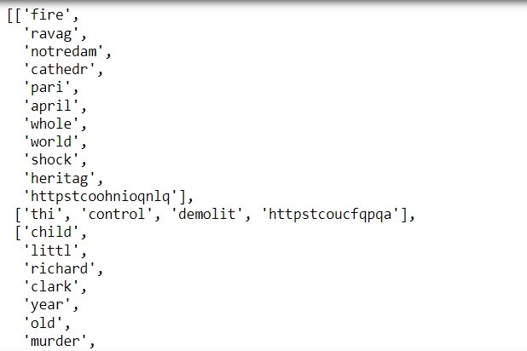
Converted words to tokens

Slide 17
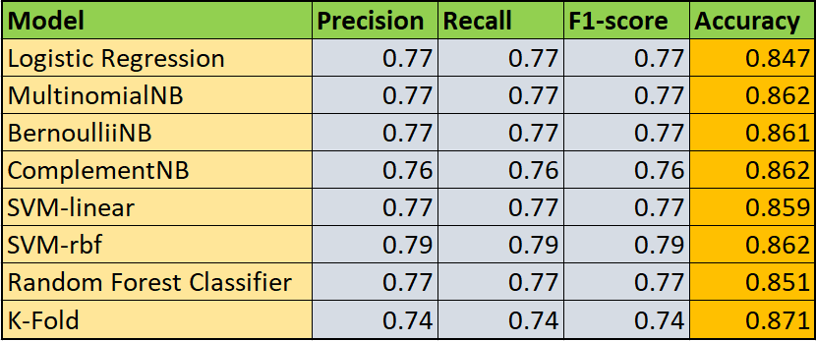
Model Building

Slide 18
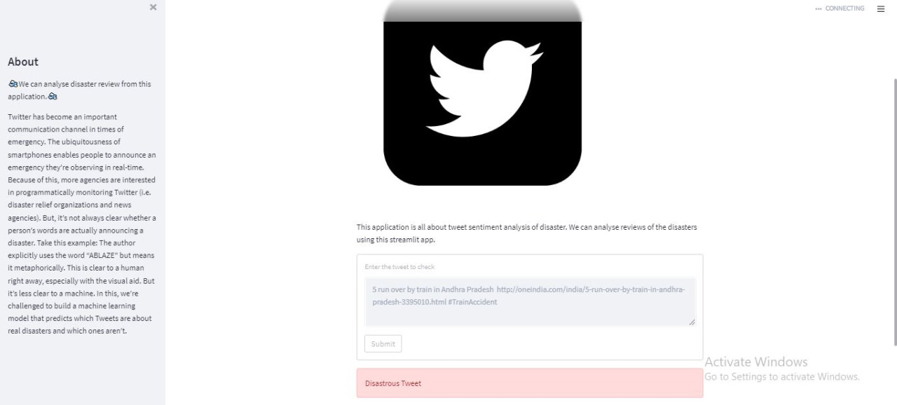
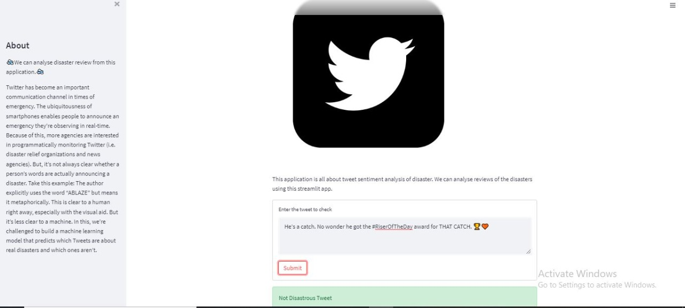
Deployment
Deployment code written using Spyder and deployed the model using Streamlit.

Slide 19
Challenges Faced
During the whole project there were several challenges, which are:-
The extraction and balancing of data had to be done more because as our data which was collected first was comparatively small.
The next challenge was to get the proper model which was done by many trials and errors.
The most hardest part of the project was deployment phase, in which we had to face many errors and took more time to complete it.

Slide 20
Thank You

